Slide 1
Planning your next vacation
By: Shireen Abedin
Notes:
Hi Everyone. My name is Shireen Abedin and I’m here today to talk about a data-driven tool I built to help you plan your next vacation. Many of you may be thinking…there are already so many resources out there for this…so what is she thinking? Well while the TripAdivsors and Lonely Planets of the world are great, but you generally need to know where you’re going to use them

Slide 2
How do you decide where to go on vacation?
Notes:
I wanted to take one step back and see if I could build a tool to help you decide where you should go. A significant consideration of the design was thinking about who’s making the decision…as you can imagine…

Slide 3




The Decision-Maker Personalities
The one with a bucket list
The predictable one
The indecisive one
The ones with too many decision makers
Notes:
there are some key personality traits that come out when you’re making these decisions….you have those who know exactly where they want to go and others who can’t make up their mind or may be traveling with a family or group with a lot of different opinions. My goal was to try to help the latter two here.

Slide 4
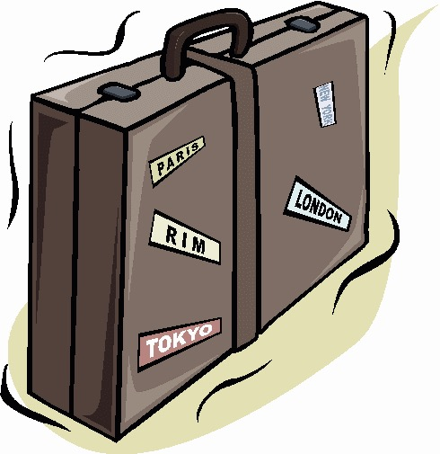
Process
Scraped TripAdvisor Activities & Reviews
Topic Modeling on Reviews
Calculated Cosine Similarity
Developed City & Activity Recommendations
Notes:
The first step to accomplish this was to gather some data.

Slide 5
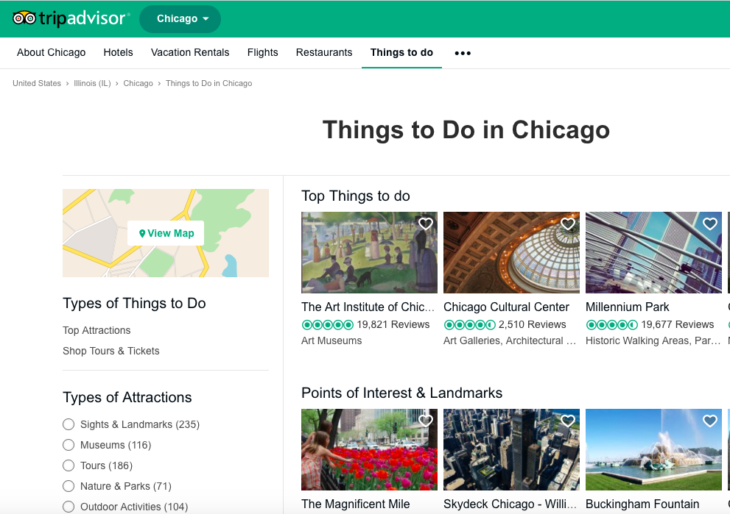
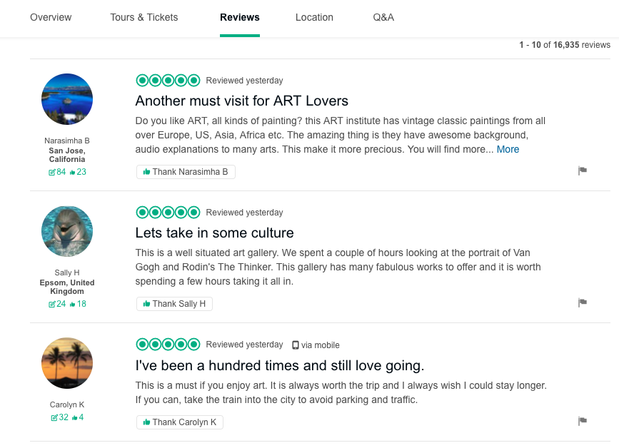
Data Acquisition
Scraped 400K reviews for 6.5K+ activities in approximately 20 cities
Notes:
I scraped TripAdvisor 400 thousand reviews on 6 thousand+ activities in ~20 cities. I was particularly interested in the reviews because I wanted to use the way people describe their experiences as proxies for the general experience of a given activity and try to find similar experiences in other places for them.

Slide 6
Process – Topic Modeling
Scraped TripAdvisor Activities & Reviews
Topic Modeling on Reviews
Calculated Cosine Similarity
Developed City & Activity Recommendations

Slide 7
Topic Modeling
LDA topic modeling for purposes of dimensionality reduction
Utilized topic distribution as representative vectors of each activity
Art Institute of Chicago | Topic 1 | Topic 2 | … | Topic 50
Review 1 | 0.025 | 0.003 | … | 0.001
Review 2 | 0.005 | 0.040 | … | 0.024
Review 3 | 0.017 | 0.010 | … | 0.034
… | … | … | … | …
Average | 0.020 | 0.015 | … | 0.009
Notes:
The next step to do this was to use natural language processing techniques in the form of topic modeling to transform the reviews into a format I could use. I did this by using LDA on the reviews which would reduce dimensionality and create a distribution of topic weights over 50 topics for each review. Then, I collapsed reviews by activity by averaging the distributions to create representative vectors for each activity and could use these to see which activities had similar topic distributions.

Slide 8
Process – Cosine Similarity
Scraped TripAdvisor Activities & Reviews
Topic Modeling on Reviews
Calculated Cosine Similarity
Developed City & Activity Recommendations
Notes:
I did this using cosine similarity which would essentially look at each activity vector and see which activities had the closest vectors to it. So we have here the Art Institute of Chicago and if we were to find the cosine similarity to the MoMa, you would see that they have very vectors that were close to each other and thus had a cosine similarity of 0.98 on a scale of 0 to 1

Slide 9
Cosine Similarities
Calculate cosine similarity between each activity-level vector
Cosine Similarity = 0.98
MoMA
Art Institute of Chicago

Slide 10
Process – Modeling
Scraped TripAdvisor Activities & Reviews
Topic Modeling on Reviews
Calculated Cosine Similarity
Developed City & Activity Recommendations
Notes:
The last step in this process was to build the actual recommendation engine.

Slide 11
Recommendation Engine
Input Cities & Activities
Find similar activities by city
Group by city and calculate average similarity
Rank cities
Sydney
Circular Quay: 0.873
Circular Quay: 0.873
Darling Harbour: 0.865
Navy Pier
Darling Harbour: 0.865
Average
= 0.913
Sydney
Museum of Contemporary Art: 0.958
#1
New York
New York
Pier 17: 0.882
Pier 66 Maritime: 0.864
Art Gallery of New South Wales: 0.955
Chicago
Museum of Contemporary Art: 0.958
Sydney
Pier 17: 0.882
Art Gallery of New South Wales: 0.955
Art Institute of Chicago
Pier 66 Maritime: 0.864
Average
= 0.927
#2
Sydney
New York
MoMa: 0.982
MoMa: 0.982
New York
The Met: 0.981
The Met: 0.981
Notes:
This is a simplified example of how it works.. The first step was to take user input of a location and activities in that location they liked. Then, I would find the activities by city that were most similar to the things they liked. Then we would reorganize this set of activities by city and take the average of their similarity metrics to see which was the overall closest city based on activities and rank accordingly.

Slide 12
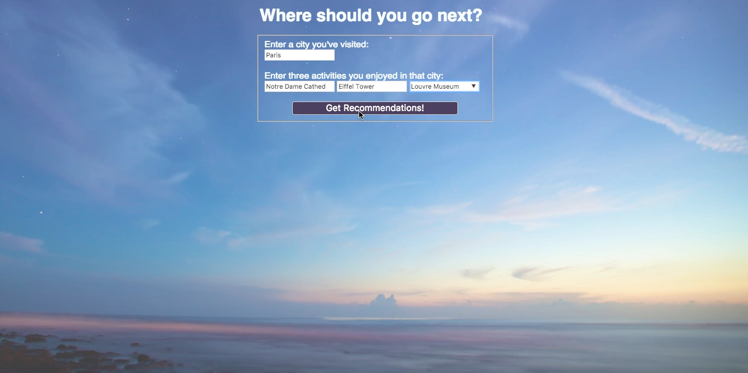
Notes:
Here is a brief demo of the tool. Let’s say we have someone who really enjoyed going to Paris and seeing some of the top attractions there like the Notre Dame, Eiffel Tower & the Louvre. They would get Florence, London and NY for recommendations and the related activities on the right here like cathedrals in Florence. If we hop over to NY we can also see some similar recommendations to the activities listed like the ESB & The Met.
But I also wanted to see how the recommendation tool would do if we had someone that didn’t necessarily want to go to the top attractions. So if we had someone who liked going to the East Village, a gallery in Chelsea and the flea market in New York.
We would see that the recommendations for London related to the East Village on the top here does fairly well recommending places with restaurants, bars and shopping. I also wanted to look at the recommendations to Paris and see if it would recommend the Louvre since we had a museum on the list and it didn’t. Instead, it recommended contemporary art galleries in Paris which I thought made more sense.
In conclusion, I believe this tool is a good resource when you want to get started on planning a vacation.

Slide 13
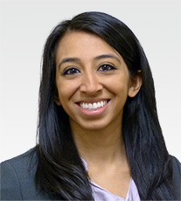
Thank you!
Shireen Abedin
shireen.f.fakhri@gmail.com
706-853-9469
www.linkedin.com/in/shireen-abedin/
Notes:
I really hope you all enjoyed my presentation and I would be happy to answer any questions after we’re done. Again, my name is Shireen Abedin. Thank you for your time.

